Slide 1
The Aussies Supremacy
IN TEST CRICKET

Slide 2
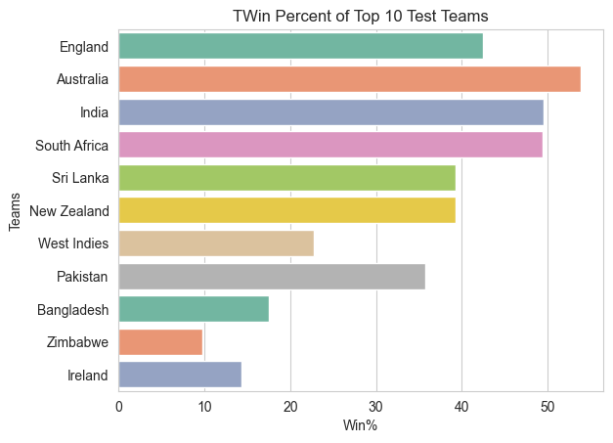




TOP AMOND WIN PERCENT
53.81%
49.52%
42.43%

Slide 3
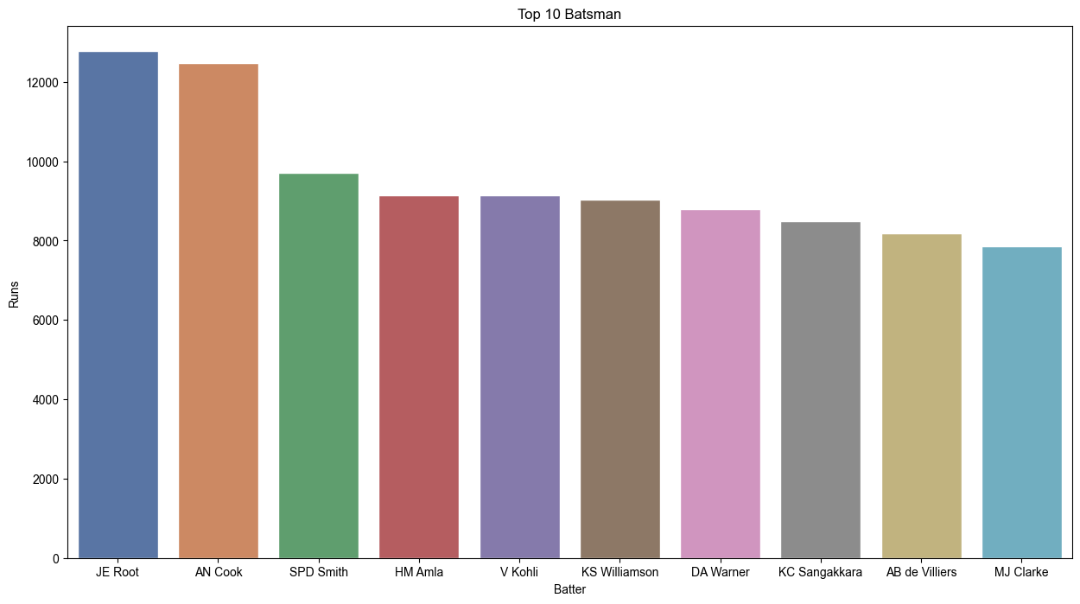

TOP AMOND BATTERS
3 OUT OF 10 TOP TEST SCORERS IN ALL TEST MATCHES FROM AUSTRALIA

Slide 4
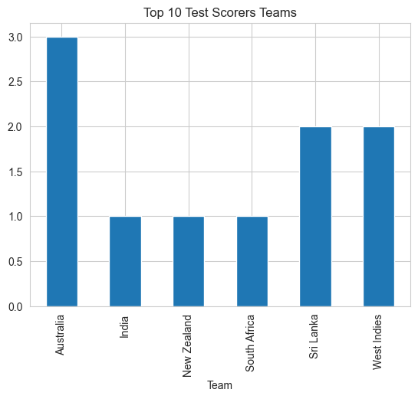
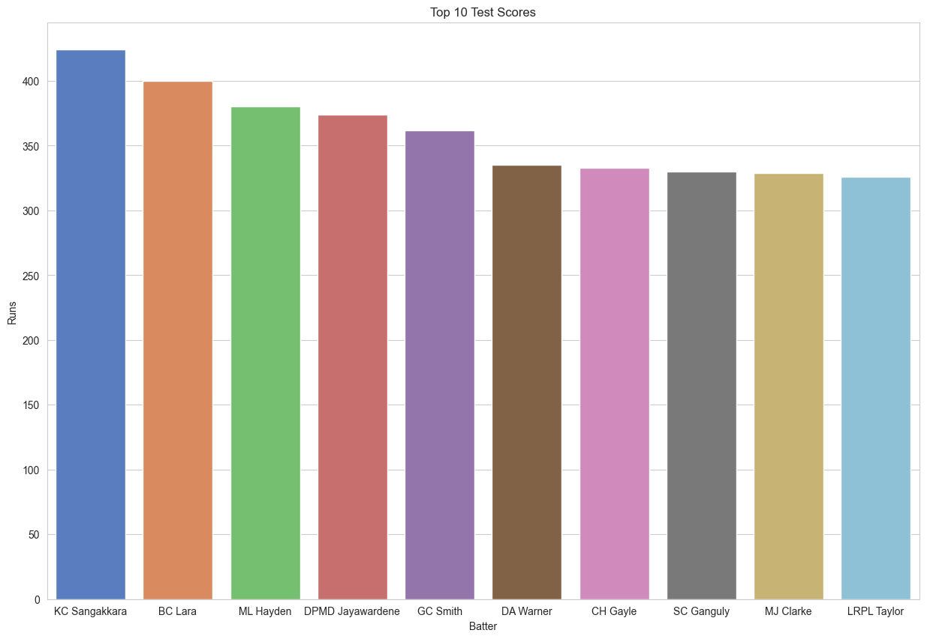
TOP AMOND BOWLERS
3 OUT OF 10 TOP TEST SCORERS IN ONE MATCH FROM AUSTRALIA

Slide 5
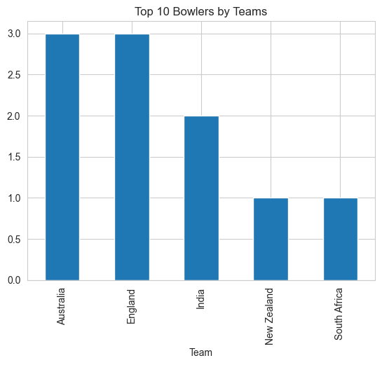
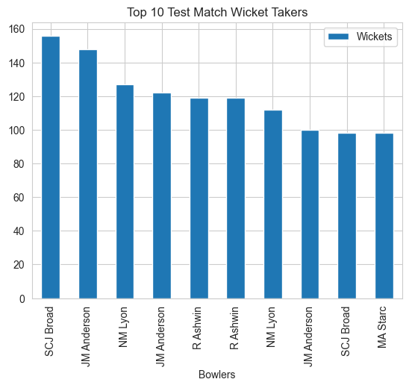
TOP AMOND BOWLERS
3 OUT OF 10 TOP TEST WICKET TAKERS FROM AUSTRALIA

Slide 6
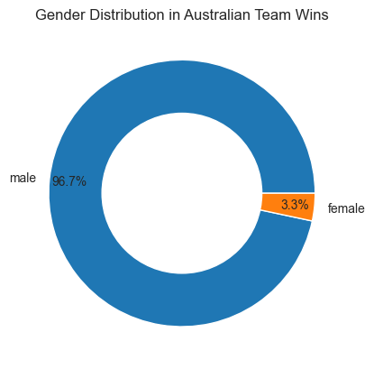

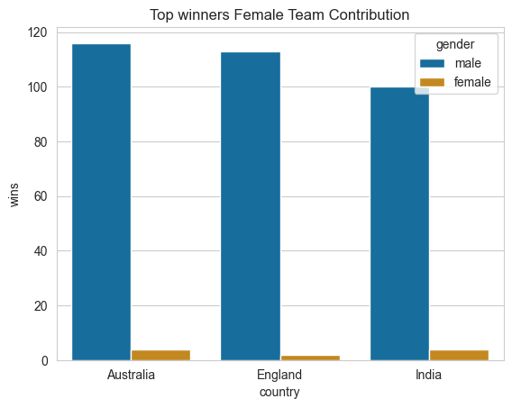
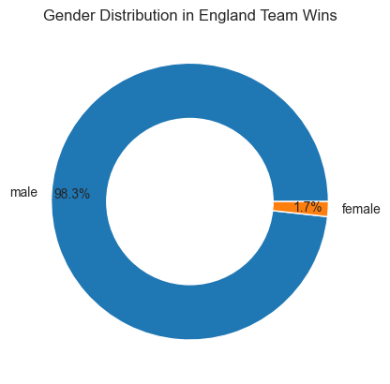
TOP AMOND BOWLERS
<
3.3% OF ALL MATCHES WON BY FEMALE CRICKET TEAM

Slide 7
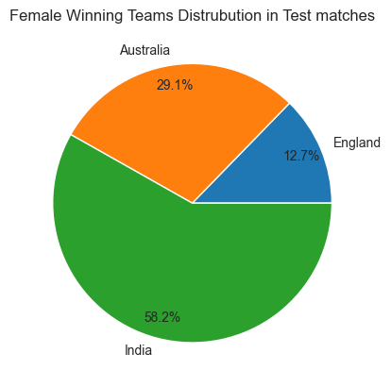
 | Teams | Matches | Wins | Win%
1 | England | 16 | 2 | 12.5000
2 | Australia | 14 | 4 | 28.5714
3 | India | 7 | 4 | 57.1429
But Indian women’s team topping the charts
in Win Percent

